Slide 1
Business Analytics
A data processing based tool for growth in business
-Shivank Agrahari
-Vibhor Kumar
-Shivam Sharma

Slide 2
Project Description
With this project we are trying to improve the growth in a sales business by understanding the past purchases and recommending a number of useful actions to the business owner. We plan to develop an E-Commerce application for the aforementioned use cases. An interface will also be developed for the customers to make the purchases of various electronic items. The UI will be enabled with various graphs and plot to give insights on various customer activities.

Slide 3
Features (User Interface)
1. Purchase + Payments
a) Create an Account
b) Add items to cart
c) payment options
2. Analyze and visualize past data
a) View past purchases using tables\Graph Plots
b) Visualize data on different scales: days\weeks\months
c) find products which can be discounted to increase sale
*d) Recommendation of items
3. Predict future requirements
a) Apply an ML or statistics based model, find patterns and predict future item requirements (count)

Slide 4
Features (backend)
1. Flask
Provide different apis between UI and Backend
2. SQL
Store: User information
Purchase data
Product Data
3. Plots
Parameterised Apis to generate and retrieve useful plots using bokeh or other python library
4. ML\Statistical Model
Trained model on collected data that can be used to predict future item purchases for inventory
*5. Recommendation System
Recommend items to customers based on their past purchases

Slide 5
Tech Stack
UI: Javascript + Angular
Other libraries: PrimeNG, Bootstrap, moment
Backend: Python + Flask
Other Libraries: Numpy, Pandas, Bokeh, SQLite, msql_connector, sklearn, scipy

Slide 6
Input/Output
Input:
Input 1: Digital Purchase receipts
Input 2: Purchase Data from website
Output:
Output 1 : Sale insight Graph Plot,e.g Category wise monthly Purchase data.
Output 2: Recommendation for Purchasing Next Items and Making Offers on some items.

Slide 7
Wireframe

Slide 8
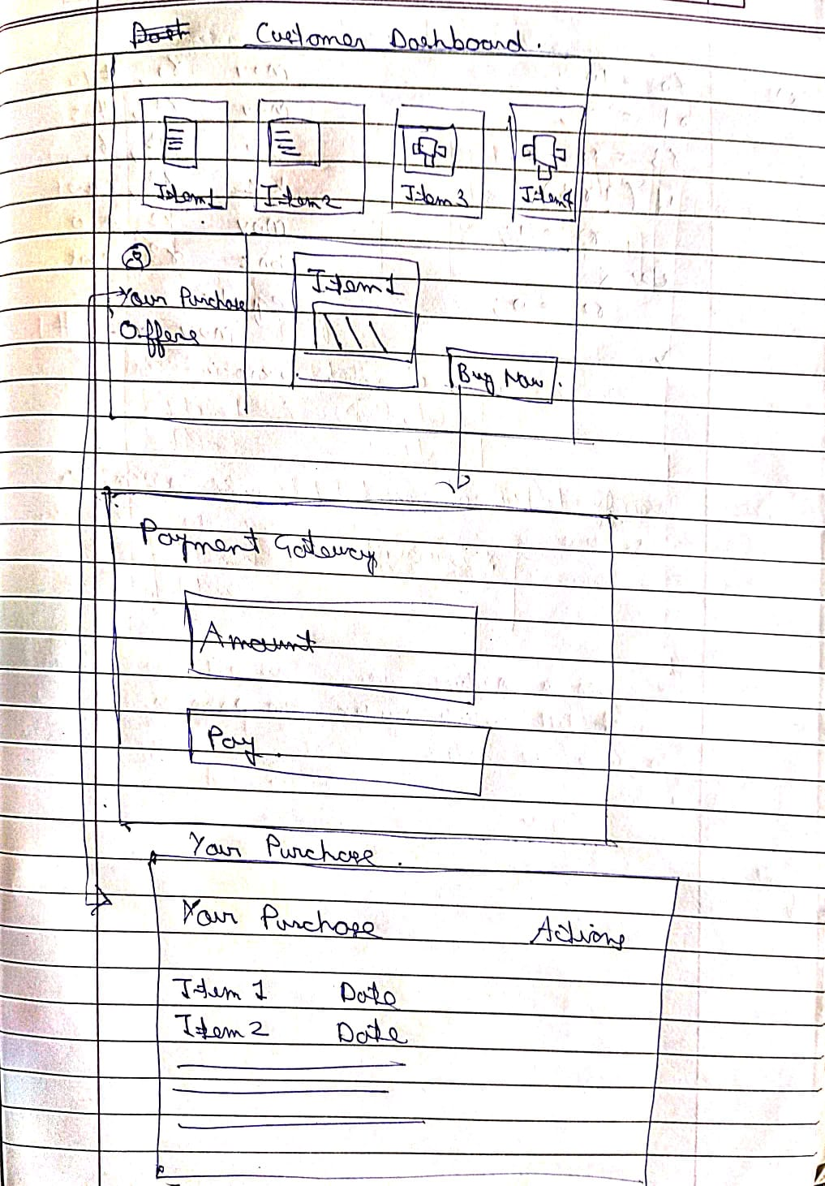

Slide 10
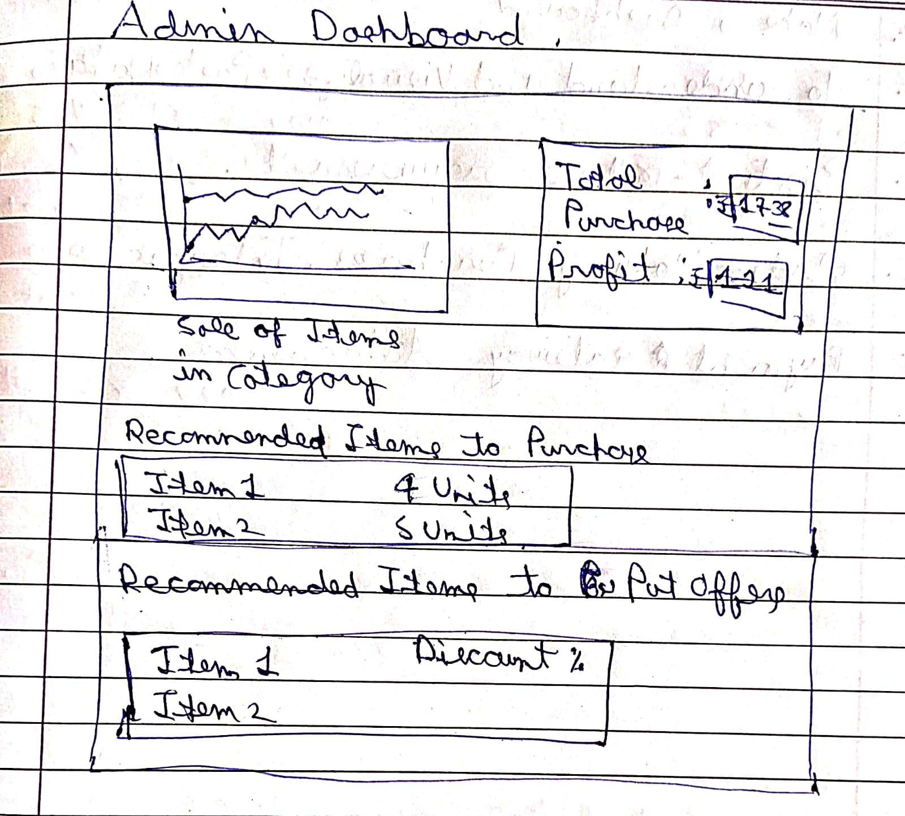

Slide 11
Milestones
Week 1: Customer UI Design + Flask API
Week 2: Customer Purchase Data Feature + SQL Data
Week 3 + 4: Prediction Models and Plotting Insights
Week 5:Payment Gateway + Final Designing
Final Evaluation: Final Documentation and Presentation

Slide 12
Contributions
Shivam: Fronend Design and Development
Vibhor: Backend Development
Shivank : Backend + Database
Note: We will add further as the project progresses.

